Slide 1
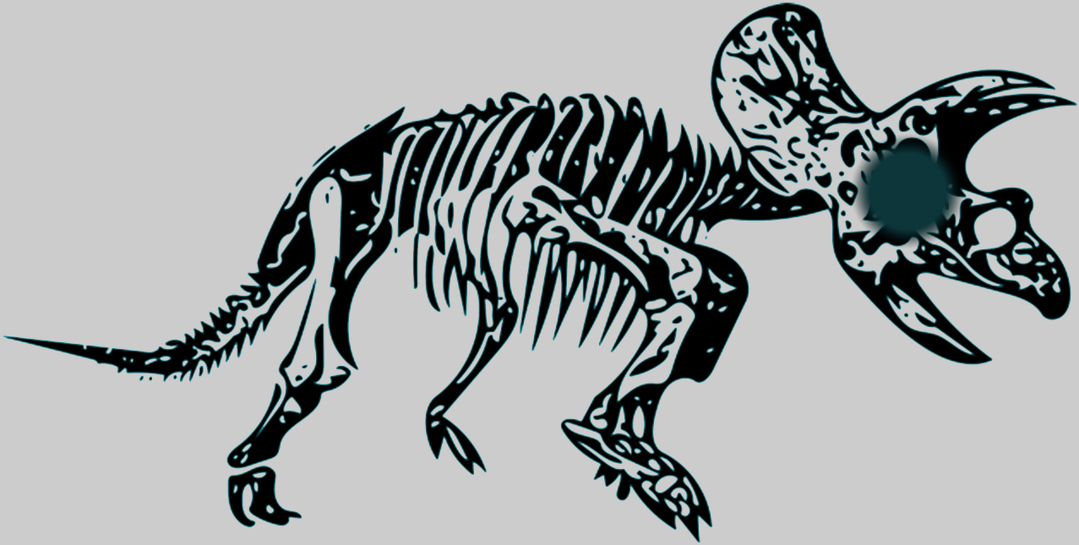
FOSSIL FUEL
PVP Dinosaur Demolition

Slide 2
Concept
Multiplayer vs. game
Combination of grid-based TBS movement and WormsTM style combat
Players take turns moving on grid, then attacking on a 2D plane

Slide 3
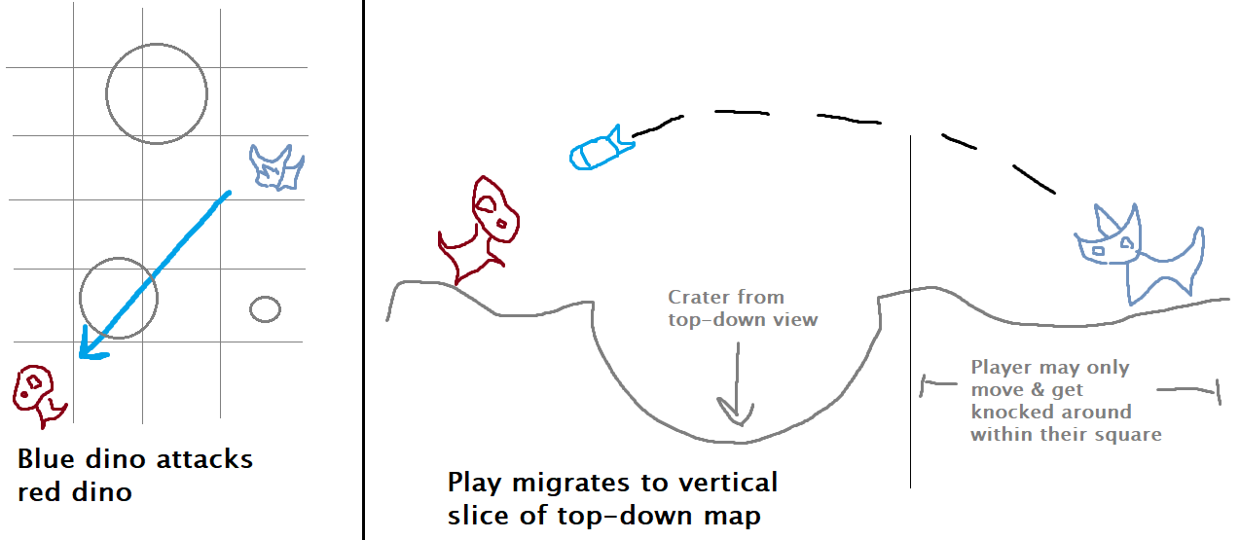
Primary Gameplay Mechanics
Destructible environment, like Worms
Environment destruction occurs in 3D space as it happens in 2D
Game takes vertical slice of playing field when an attack is initiated

Slide 4
Turns
Each player takes their turn like so:
Choose dino to move
Move dino
Choose enemy dino to attack
Gameplay switches to vertical slice
Choose weapon (missile, grenade, etc)
Shoot

Slide 5

Prevail...
Or become Fossil Fuel.

